Slide 1


2023 IEEE Fifth International Conference on Advances in Electronics, Computers and Communications ICAECC 2023 - ( IEEE Conference Record #59324 ), 7th & 8th September 2023
Paper ID : 189
Title of the paper: Fake News Detection Using Ensemble Approach
Author Names: Avadhoot Tavhare, Siddhant Choudhary, Kunal Borle, Sunita Barve, Diptee Chikmurge
Author Affiliations: MIT Academy of Engineering

Slide 2
CONTENTS
Abstract
Introduction
Literature Survey
Problem Definition
Proposed Methodology
Hardware & Software Specification
Results & Discussions
Conclusion
References

Slide 3
Abstract
Ensemble-based technique for fake news detection.
Classifier types: Support Vector Machine, Decision Tree, Passive Aggressive Classifier, and Artificial Neural Network.
Fake News Dataset labelled as ‘0’ or ‘1’.
Data preprocessing: text cleaning, tokenization, and stemming.
Ensemble model with voting classifier achieved maximum accuracy.
Potential impact on journalism, media, politics, and public policy.

Slide 4
Introduction
Fake News Epidemic: In recent years, the proliferation of fake news has surged, largely due to the widespread use of social media and online channels for information dissemination.
Inaccurate Information Spread: The rapid spread of inaccurate information and disinformation poses significant challenges. This phenomenon can have adverse consequences on individuals, organizations, and society as a whole.
Impact on Society: Fake news influences public opinion, disrupts trust in institutions, and can even contribute to social unrest. It is imperative to address this issue for the well-being of society.
Ensuring Factual Information: It is now more crucial than ever to ensure that people have access to reliable and fact-based information, safeguarding the integrity of public discourse.
Identifying Fake News: To lessen its negative consequences and uphold the trustworthiness of information sources, it is important to develop effective techniques and equipment to recognize and dispute fake news.

Slide 5
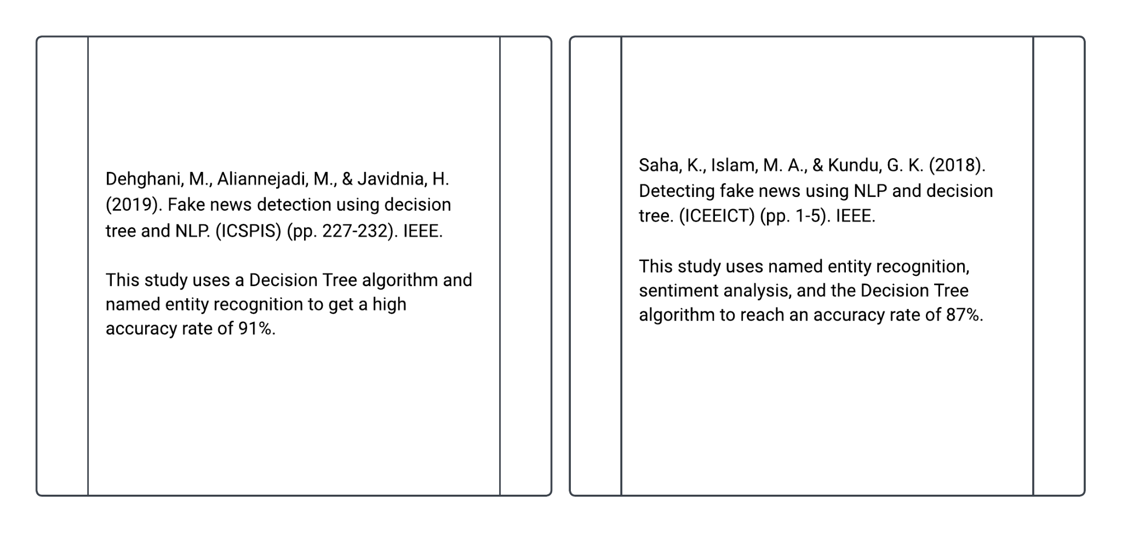
Literature Survey
Notes:
Write research gaps
Ensemble

Slide 6
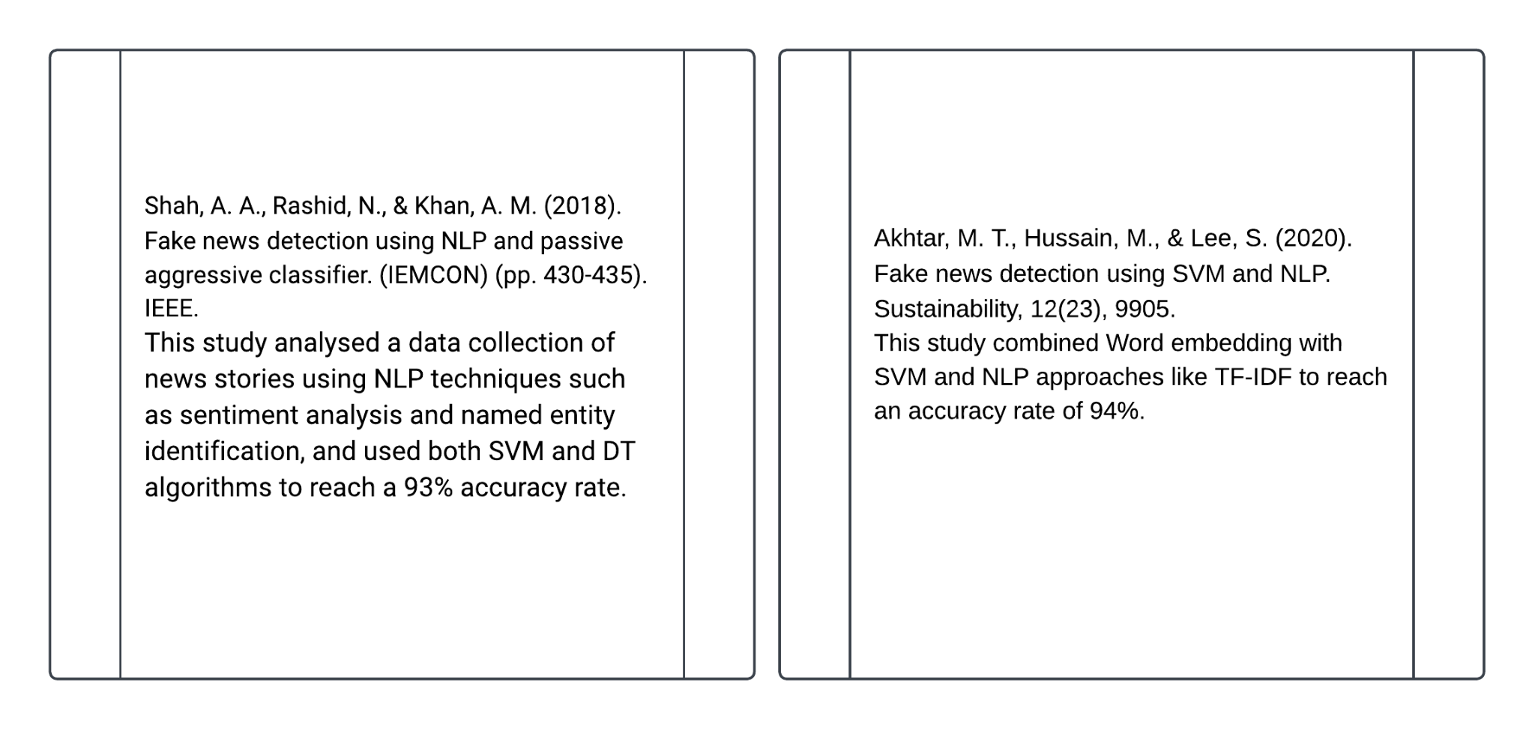

Slide 7
Problem Definition
The spread of misinformation and fake news articles can have far-reaching consequences, including the manipulation of public opinion, undermining trust in media, and even influencing political outcomes
The problem is to design an ensemble-based machine learning approach that enhances the reliability of fake news detection systems.
The problem is to explore the use of ensemble learning techniques to combine the strengths of multiple classifiers for more accurate and reliable fake news detection.

Slide 8
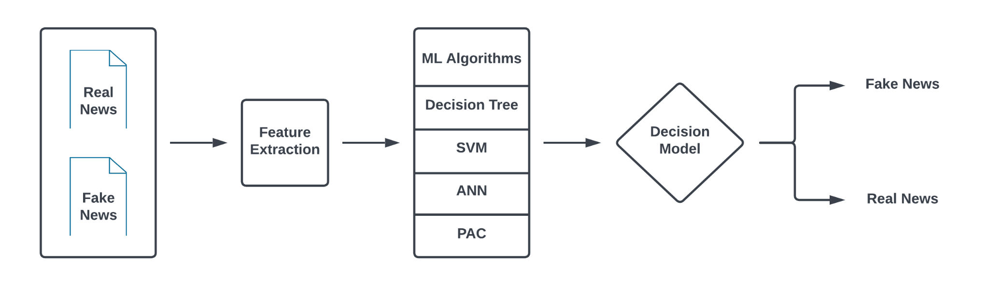
Proposed Methodology
Working of the Implementation

Slide 9
Proposed Methodology
Data Preprocessing: Split data into training and testing sets.
Individual Classifier Accuracy: Evaluate DT, ANN, PAC, and SVM individually.
Voting Classifier: Selecting base classifier for the ensemble model.
Ensemble Model: Fitting data into the ensemble model.
Evaluation Metrics: Measure performance using F1 score, accuracy, recall, and precision.
Ensemble Techniques: Apply Random Forest Classifier, AdaBoost, and Bagging Classifier

Slide 10
Hardware & Software Specification
Hardware Specification:
High-performance CPU (e.g., Intel Core i9 or AMD Ryzen 9).
High-computation GPU with CUDA support (e.g., NVIDIA GeForce RTX 30 series or AMD Radeon RX 6000 series).
32GB+ DDR4 RAM.
500GB+ SSD storage.
Software Specification:
OS: Windows 10/11, macOS, or Ubuntu 20.04 LTS.
Latest GPU drivers.
Python 3.7+.
Package management with pip or conda.
Key packages: TensorFlow (GPU version), Keras, NumPy, Pandas.
Jupyter Notebook or JupyterLab.
Google Colab integration (requires Google account and internet access).

Slide 11
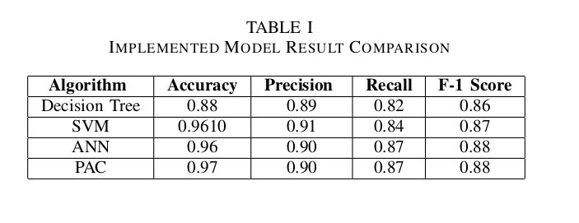
Results & Discussions
Results:
Ensemble model combining SVM, ANN, PAC, and DT significantly improves accuracy for fake news detection.
Ensemble model achieves high accuracy (0.97) and precision in detecting false news.
SVM and DT classifiers in the ensemble perform well at spotting fake news.

Slide 12
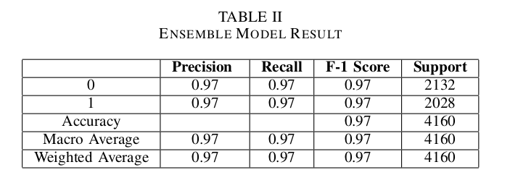
Results & Discussions
Discussions:
Ensemble models effectively enhance false news detection accuracy and reliability.
Visualization of accuracy scores confirms the success of the implemented approach.
Ensemble models play a crucial role in improving false news detection systems and reducing misinformation spread.

Slide 13
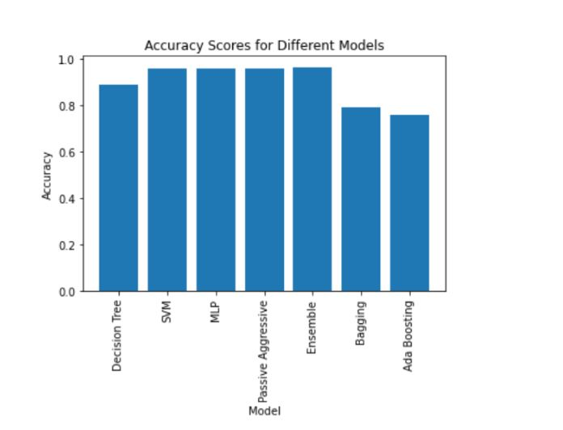
Conclusion
Ensemble approach with multiple classifiers outperforms individual classifiers in accuracy.
For better performance and early model development and training use Google colab.
Machine learning frameworks used: TensorFlow, Keras, and Scikit-learn.
Model parameters optimized using cross-entropy loss during training.
Performance monitored with F1 score, accuracy, recall, precision.
Testing phase evaluated model's ability to generalize to new data.

Slide 14
References
Mhaskar, N. N., & More, S. A. (2021). Fake News Detection using Ensemble Approach with SVM and Decision Tree. Journal of Ambient Intelligence and Humanized Computing, 12(9), 10127-10136.
Dehghani, M., Aliannejadi, M., & Javidnia, H. (2019). Fake news detection using decision tree and NLP. In 2019 6th International Conference on Signal Processing and Intelligent Systems (ICSPIS) (pp. 227-232). IEEE.
Saha, K., Islam, M. A., & Kundu, G. K. (2018). Detecting fake news using NLP and decision tree. In 2018 4th International Conference on Electrical Engineering and Information & Communication Technology (ICEEICT) (pp. 1-5). IEEE.
Shah, A. A., Rashid, N., & Khan, A. M. (2018). Fake news detection using NLP and passive aggressive classifier. In 2018 IEEE 9th Annual Information Technology, Electronics and Mobile Communication Conference (IEMCON) (pp. 430-435). IEEE.
Akhtar, M. T., Hussain, M., & Lee, S. (2020). Fake news detection using SVM and NLP. Sustainability, 12(23), 9905.
Saifullah, M. K., Irfan, M., & Haq, M. U. (2019). Fake news detection on Twitter using SVM and NLP. In 2019 International Conference on Engineering and Emerging Technologies (ICEET) (pp. 1-6). IEEE.

Slide 15
THANK YOU

